Slide 1
User Requirements Based on the User Stories
<Group Conqueror>

Slide 2
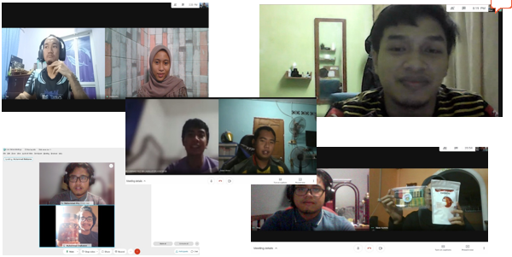

Users
Seller
Customer
<Description of User>
User who use the application to promote and sell their product.
They can use the application as their platform to gain income.
<Description of User>
User who use the application to find and buy their desired product.

Slide 3
User and Stories

Slide 4
Seller
Customer
USER STORY 1
As a seller, I want to register my product, So I can promote and sell it.
USER STORY 1
As a customer, I want to find a product, So I can buy it.
USER STORY 2
As a seller, I want to store all transaction data, So I can avoid data lost.
USER STORY 2
As a customer, I want to select my payment type, So I can pay the product.
USER STORY 3
As a seller, I want to get feedback from customer, So I can improve the service.
USER STORY 3
As a customer, I want to make payment, So I can get the product.
USER STORY 4
As a seller, I want to get customer full detail, So I can deliver the product.
USER STORY 4
As a customer, I want to update my information, So I can avoid wrong details.

Slide 5
Seller Story Card - 1
As a
Seller
I want to
Register my product
Promote and sell it
So I can
Description
Get the seller information
Get the product information
Check the registration status
Display the registered product
Acceptance Criteria
The product can be registered
The product can be display
The interface will be in suitable format

Slide 6
Seller Story Card - 2
As a
Seller
I want to
Store all transaction data
Avoid data lost
So I can
Description
Get the transaction information
Check the transaction information
Get the seller confirmation
Store all data in the database
Acceptance Criteria
The transaction is already happen
The transaction details is collected
Database space is available

Slide 7
Seller Story Card - 3
As a
Seller
I want to
Get feedback from customer
Improve the service
So I can
Description
Customer buy the product
Customer give feedback of the product
Seller display the feedback for future use
Acceptance Criteria
The customer buy the product
The customer receive the product

Slide 8
Seller Story Card - 4
As a
Seller
I want to
Get customer full detail
Deliver the product
So I can
Description
Customer fill the details
Seller receive the customer details
Seller use the detail to deliver product
Acceptance Criteria
Customer already fill the details
Customer accept the terms and condition that the details is used by the seller

Slide 9
Customer Story Card - 1
As a
Customer
I want to
Find a product
Buy it
So I can
Description
Get the product price
Get the customer payment type
Generate the receipt
Acceptance Criteria
The product can be pay
The customer can pay
The interface will be in suitable format

Slide 10
Customer Story Card - 2
As a
Customer
I want to
Select my payment type
Pay the product
So I can
Description
Get the product details
Get the customer information
Check if the product is available
Calculate the price of the product
Display total price
Acceptance Criteria
The product can be search
The product can be bought
The interface will be in suitable format

Slide 11
Customer Story Card - 3
As a
Customer
I want to
Make Payment
Get the product
So I can
Description
Get the customer payment type.
Get the customer bank detail.
Get the customer billing address.
Generate the receipt
Acceptance Criteria
The product can be pay
The amount of money in customers’ account is sufficient.
The interface will be in suitable format

Slide 12
Customer Story Card - 4
As a
Customer
I want to
Update Information Details
Avoid wrong detail
So I can
Description
Get the customer detail.
Get the customer security word.
Get the customer confirmation email address.
Generate the receipt
Acceptance Criteria
The update detail is relevant.
The security word is true.
The customer get the link for confirmation email address.
The interface will be in suitable format

Slide 13
Food4U Application
Seller
Customer
System Admin
Register Product
Find Product
Confirm Registration
Store Transaction Data
Select Payment Type
Approve Product
Get Feedback
Make Payment
Validate Seller
Get Details
Update Information Details

Slide 14
Food4U Application Schedule
Seller
Customer
System Admin
Sprints 1
Register Product
Find Product
Confirm Registration
Sprints 2
Store Transaction Data
Select Payment Type
Approve Product
Sprints 3
Get Feedback
Make Payment
Validate Seller
Sprints 4
Update Information Details
Get Details

